Slide 1
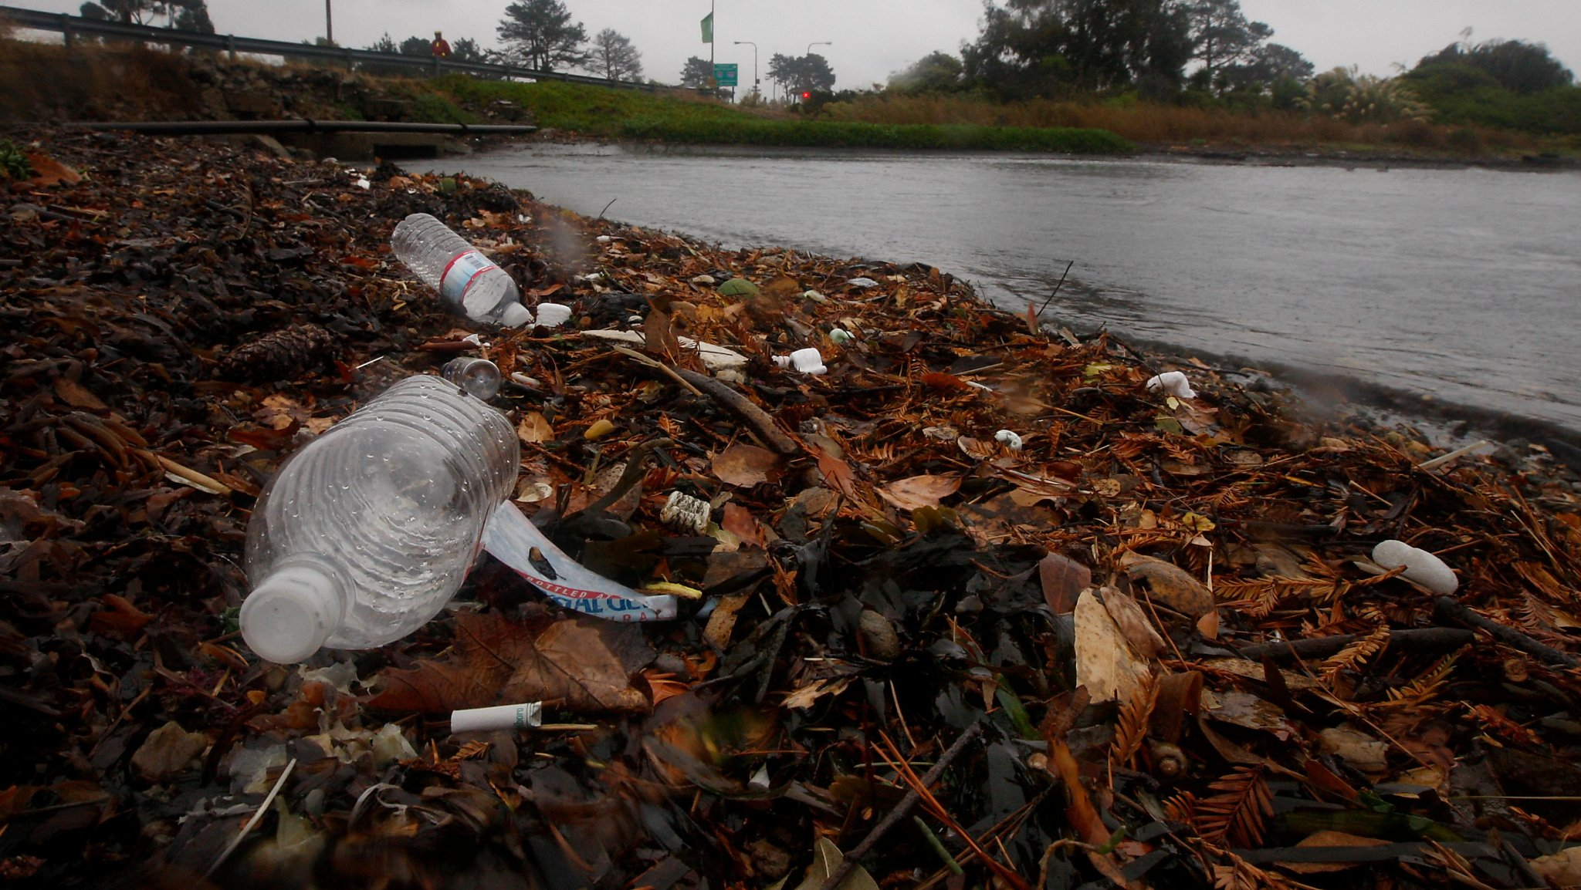
Pollution in the SF Bay
By Colin Santos

Slide 2
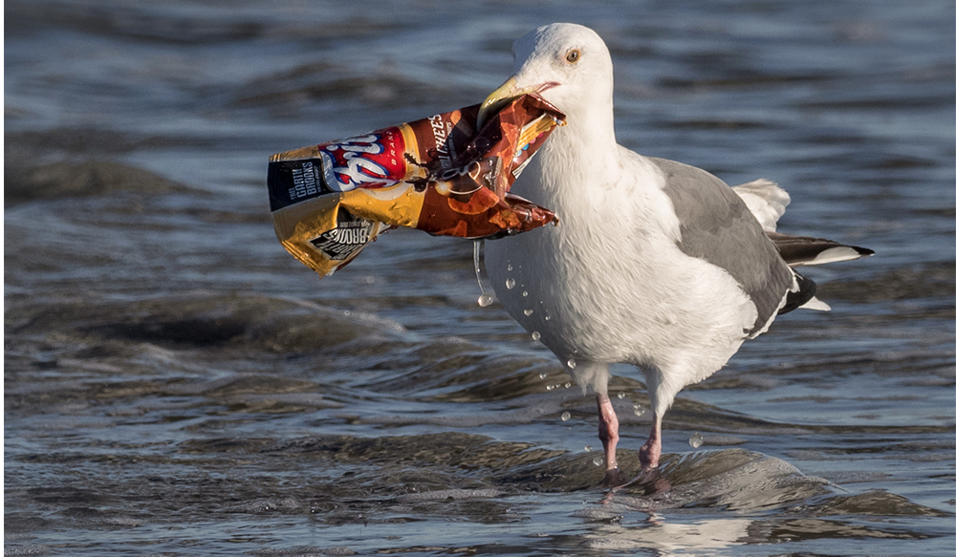
Trash and pollution are negatively impacting plants, animals, humans, and the environment at or near the bay.

Slide 3
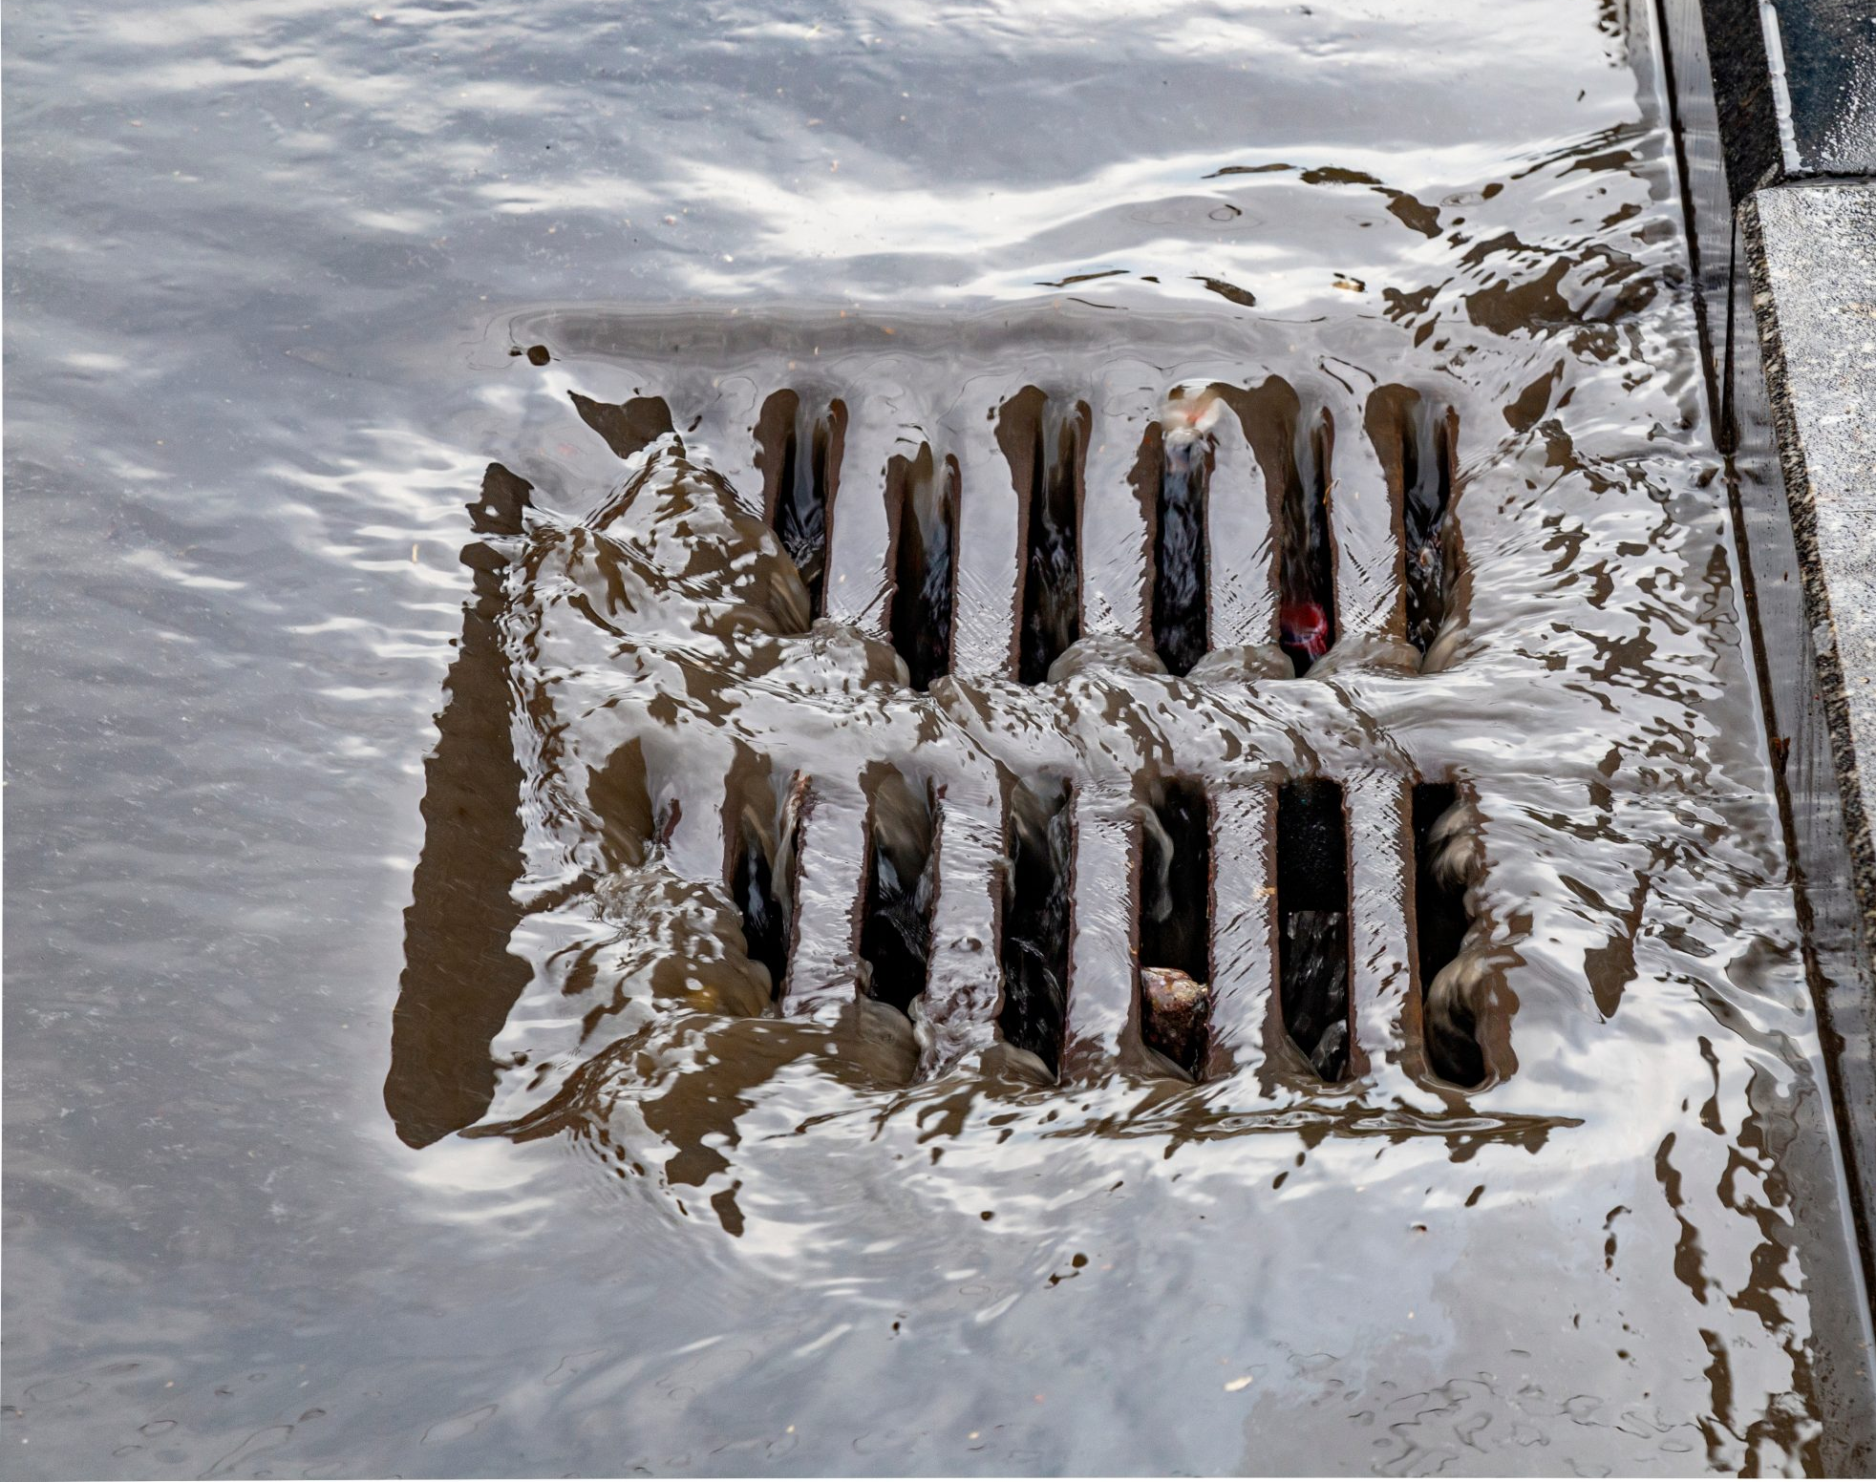
Stormwater Flow
Rain and irrigation runoff flow across impervious surfaces like rooftops, paved roads, and oversaturated lawns
Picks up and carries pollutants
Storm drains at the curb carry toxic trash and other pollution directly into local creeks and the bay
Often without treatment or filtration
Makes waterways unsafe for recreational contact and fishing
Save The Bay: Bay Area wastewater treatment plants release an estimated 7,000,000 particles per day to San Francisco Bay

Slide 4
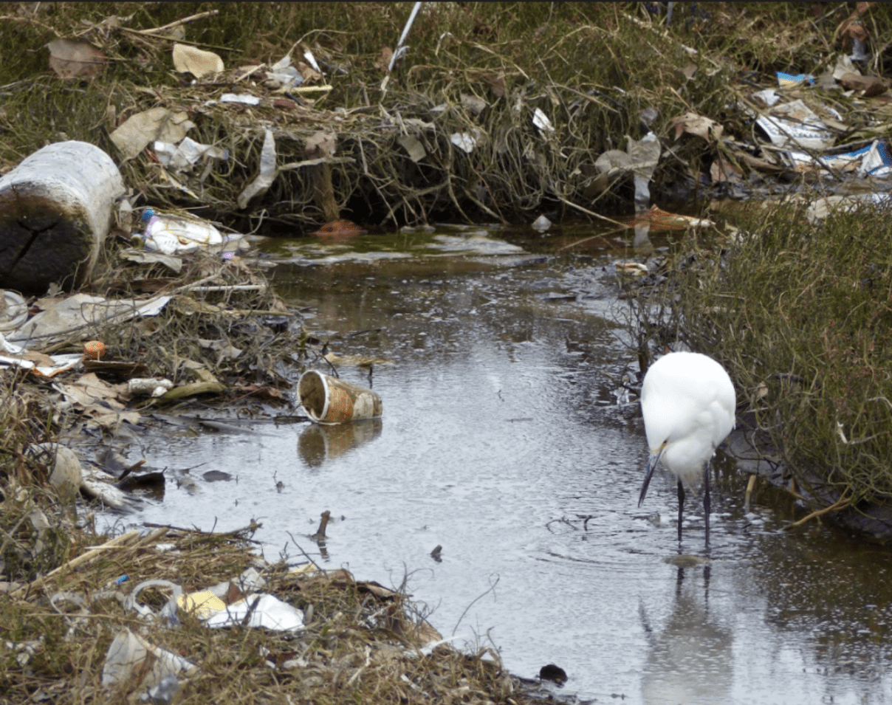
Contamination from Chemicals
Pesticides, fertilizers, high PCBs, mercury concentrations, other chemicals flow into the bay from upstream
Harmful to bay’s plant and animal populations
Cause algae to grow at faster rate, animal populations to die
Impairs animals’ natural abilities, destroys natural habitats
Fish unsafe to eat
Algal blooms can be dangerous to humans; can cause rashes/respiratory illnesses

Slide 5
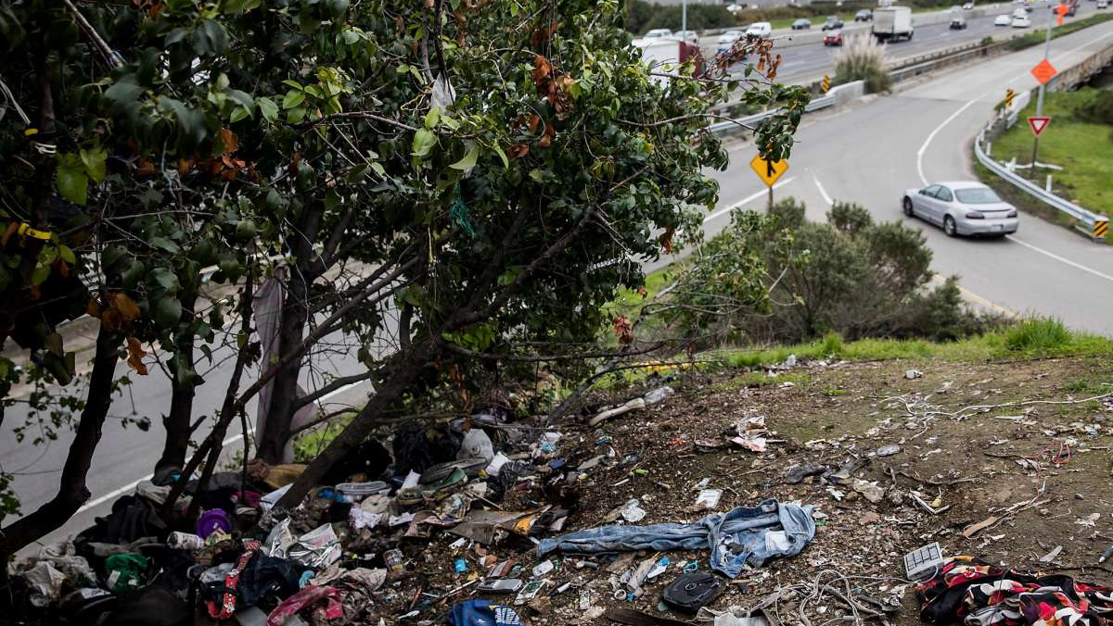
Highway/Road Pollution
Highways and state roads are major sources of trash flows to the bay
Poisons fish and wildlife
Endangers public health
Trash from freeways and state roads pour through storm drains into creeks, flows right into SF bay
Plastic bottles, wrappers, Styrofoam, straws, etc.

Slide 6
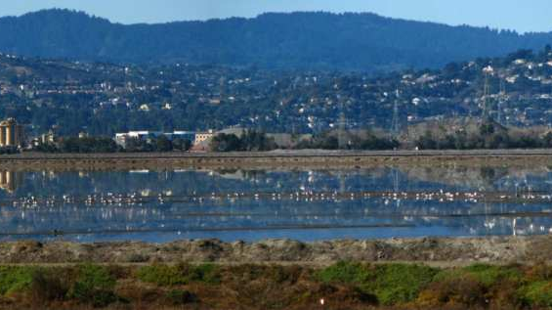
Regulation and Enforcement
Baykeeper: Region-wide regulations adopted in 2009 require Bay Area city governments to control storm water pollution
  Required to reduce pesticide use in parks, city-owned land, roadway median strips, city buildings
  Required to ensure that new development projects include low-impact development features
Flows To Bay/EPA: Federal Clean Water Act and California Porter-Cologne Water Quality Control Act require large urban areas discharging stormwater into the SF bay or Pacific Ocean to have a permit and be able to control pollutant discharges using the National Pollutant Discharge Elimination System
However, local and state government agencies like Caltrans aren’t enforcing these laws and are violating both federal law and state storm water permits -The Mercury News

Slide 7
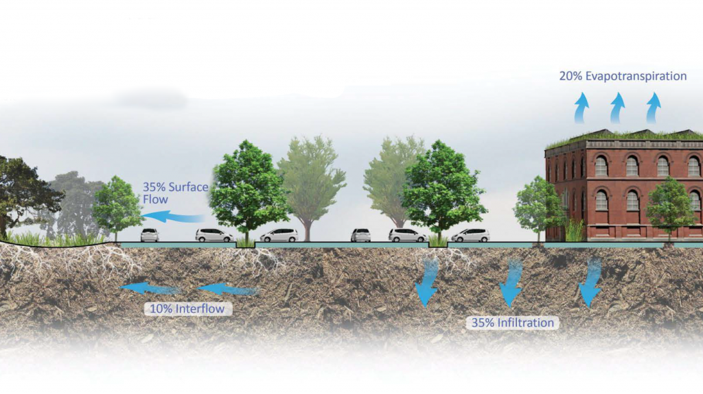

Management
Low-impact development features aim to stop storm water pollution before it occurs by designing buildings, roads, and public areas in a way that mimic nature’s way of processing water
Allow rainwater to percolate, filter, and gradually flow into groundwater, creeks, streams, and the bay
Green infrastructure can help lessen the impacts of heavy storms
Employs natural filtering processes which reduce water pollutants from entering the bay
Mitigates flood risk by slowing and reducing stormwater runoff
Captures and increases stormwater infiltration into the ground
Source: Flows To Bay

Slide 8
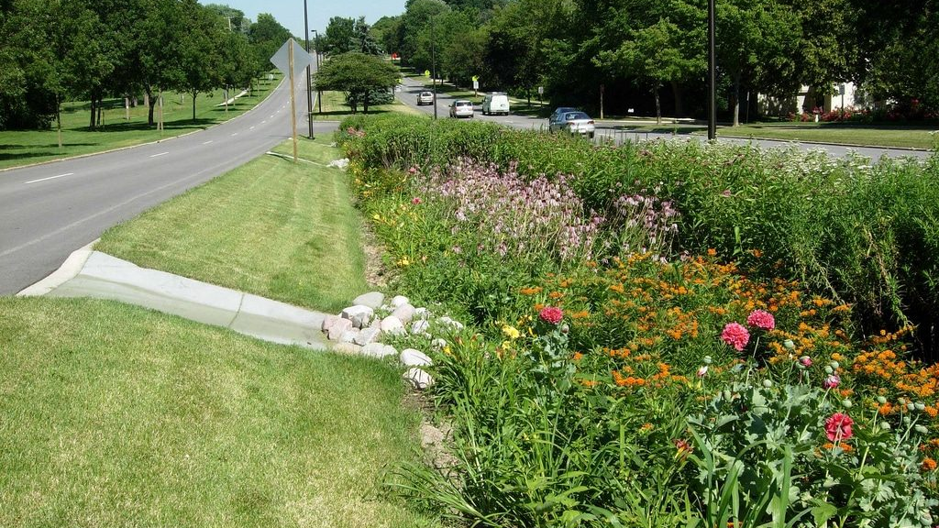
Challenges
Low-impact developments challenges -BLR
  Tend to involve more ongoing maintenance and landscaping
  Vegetated filter strips more ideal for small parking lots
  Increases erosion during large storm events
  Increases pavement failure
  Needs to be properly designed
Spotty enforcement of clean water regulations
Water & Wastes Digest: In California, officers travel to various construction sites inspecting for violations – the subject fines generate revenue for continued enforcement

Slide 9
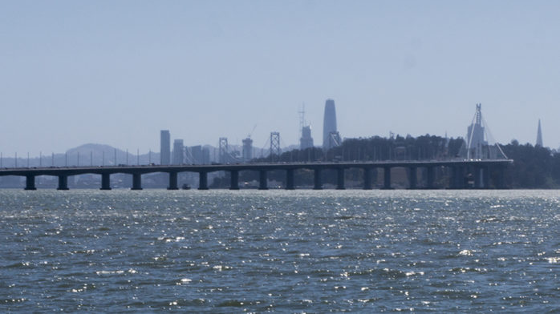
Call to Action: Local and State Governments
Local and state governments should pass laws that help with better enforcement of existing clean water regulations
Adequate funding to help reduce impacts of pollution
Water Education Foundation: California Bill AB-377, introduced in February 2021, aims to eliminate water impairment by 2050 and would strengthen enforcement to ensure all permittees comply with clean water standards

Slide 10
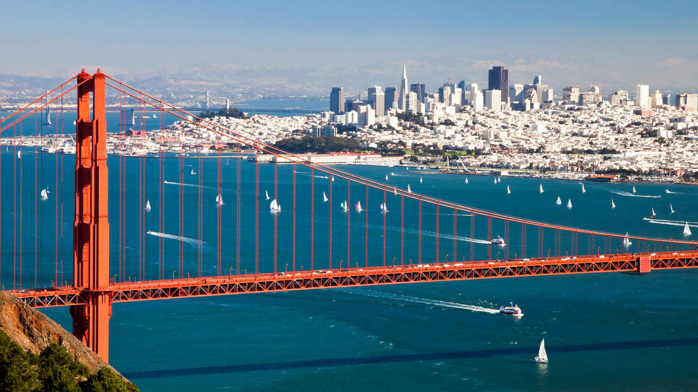
Call to Action: General Public
The general public should be aware of their environmental impact
Take steps to reduce the amount of waste that could harm the environment
Avoid throwing toxic materials and unwanted medication in garbage bins or down the toilet
Properly dispose and recycle items – waste disposal facilities
Reuse rainwater for irrigating gardens or watering indoor plants
Direct rainwater to a garden containing drought-resistant plants
Don’t wash your car in a driveway or on the street – this sends harmful chemicals into storm drains and ends up in the bay
Limit use of pesticides and fertilizers – these can be washed off your lawn
Dispose of litter responsibly and limit use of disposable items
Support funding increases for infrastructure improvements

Slide 11
Works Cited
“Preventing Pollution.” Save The Bay, 31 May 2019, https://savesfbay.org/what-we-do/preventing-pollution.
“Controlling Urban Storm Water Pollution.” San Francisco Baykeeper, 30 Apr. 2021, https://baykeeper.org/our-work/controlling-urban-storm-water-pollution.
“Sustainable Stormwater Management.” Flows to Bay, https://www.flowstobay.org/about/why-we-do-it/sustainable-stormwater-management/.
“Stormwater Pollution Prevention.” Flows to Bay, https://www.flowstobay.org/about/what-we-do/stormwater-pollution-prevention/.
“Green Infrastructure.” Flows to Bay, https://www.flowstobay.org/preventing-stormwater-pollution/in-my-community/green-infrastructure/.
Lewis, David. “Opinion: State Must Stop Caltrans Pollution of San Francisco Bay.” The Mercury News, The Mercury News, 13 Nov. 2018, https://www.mercurynews.com/2018/11/13/opinion-crack-down-on-caltrans-trash-pollution/.
“Op-Ed: California Needs to Repeat History by Passing New Clean Water Laws.” Los Angeles Times, Los Angeles Times, 20 Mar. 2021, https://www.latimes.com/opinion/story/2021-03-20/california-nation-clean-water-laws.
The Pros and Cons of Low-Impact Development, https://enviro.blr.com/environmental-news/water/stormwater-general/The-pros-and-cons-of-low-impact-development.
“The Challenges of Stormwater Management.” Water & Wastes Digest, 8 June 2021, https://www.wwdmag.com/groundwater/challenges-stormwater-management.
EPA, Environmental Protection Agency, https://www.epa.gov/laws-regulations/summary-clean-water-act.
“Blog: Proposed ‘California Clean Water Act’ (AB 377) Would Restrict Ability to Secure Schedules of Compliance in Water Quality Permits or Other Water Quality-Related Orders.” Water Education Foundation, https://www.watereducation.org/aquafornia-news/blog-proposed-california-clean-water-act-ab-377-would-restrict-ability-secure.

